Slide 1
Smart Study Habit Tracker (SSHT)
Presented by:
Malak Srour
Aya Hassan
For: Dr. Mohammad Aoudi

Slide 2
01
INTRODUCTION
SSHT is a full-stack web application designed to help students monitor, analyze, and enhance their study patterns. By collecting daily study data, the system evaluates potential burnout risks using both rule-based logic and a machine learning model. Furthermore, it integrates ChatGPT-4 to provide intelligent and personalized feedback, offering actionable advice based on user behavior. This project aims to foster better academic habits through data-driven insights and AI assistance

Slide 3
02
OBJECTIVE
Collect and monitor user study habit data including study time, sleep, breaks, and concentration.
Analyze collected data for burnout risk using both rule-based and machine learning approaches
Integrate ChatGPT-4 as an AI coach providing natural language suggestions.
Offer intuitive, historical feedback through visual indicators and history lists.
Provide a responsive, real-time, interactive user interface

Slide 4
03
TECHNOLOGY STACK
Frontend
React.js
Styling
CSS Modules
Backend
Python with Flask
AI Integration
OpenAI ChatGPT-4 API
Database
SQLite
Machine Learning
Scikit-learn and RandomForest

Slide 5
04
System Architecture
Frontend (React)
Collects user data through forms
Validates input and sends to backend
Displays analysis results with visualization (risk bars, ratings)
Allows session history browsing and deletion
Backend (Flask)
Accepts input from frontend via API
Applies rule engine and ML model to assess burnout
Communicates with OpenAI ChatGPT-4 to generate advice
Stores and retrieves session data from SQLite

Slide 6
04
System Architecture
Storage (SQLite)
Stores user session records for historical tracking
Queries filtered by username and time range (hour, day, week, etc.)
AI Agent (ChatGPT-4)
Generates custom advice for each session based on data like hours studied, sleep, and concentration
Advice is concise, motivational, and actionable

Slide 7
05
Functional Components
SSHT/
├── backend/
│ ├── app.py
│ ├── database.py
│ ├── models/
│ │ ├── burnout_model.py
│ │ └── rule_engine.py
│ └── .env
│ └── data/
│ │ ├─burnout_data.csv
│ │ ├─ generate_data.py
SSHT/
├── frontend/
│ ├── src/
│ │ ├── App.jsx
│ │ ├── App.css
│ │ ├── components/
│ │ │ ├── FormInput.jsx
│ │ │ ├── FormInput.css
│ │ │ ├── ResultCard.jsx
│ │ │ ├── ResultCard.css
│ │ │ ├── HistoryList.jsx
│ │ │ ├── HistoryList.css
│ │ │ └── Header.jsx

Slide 8
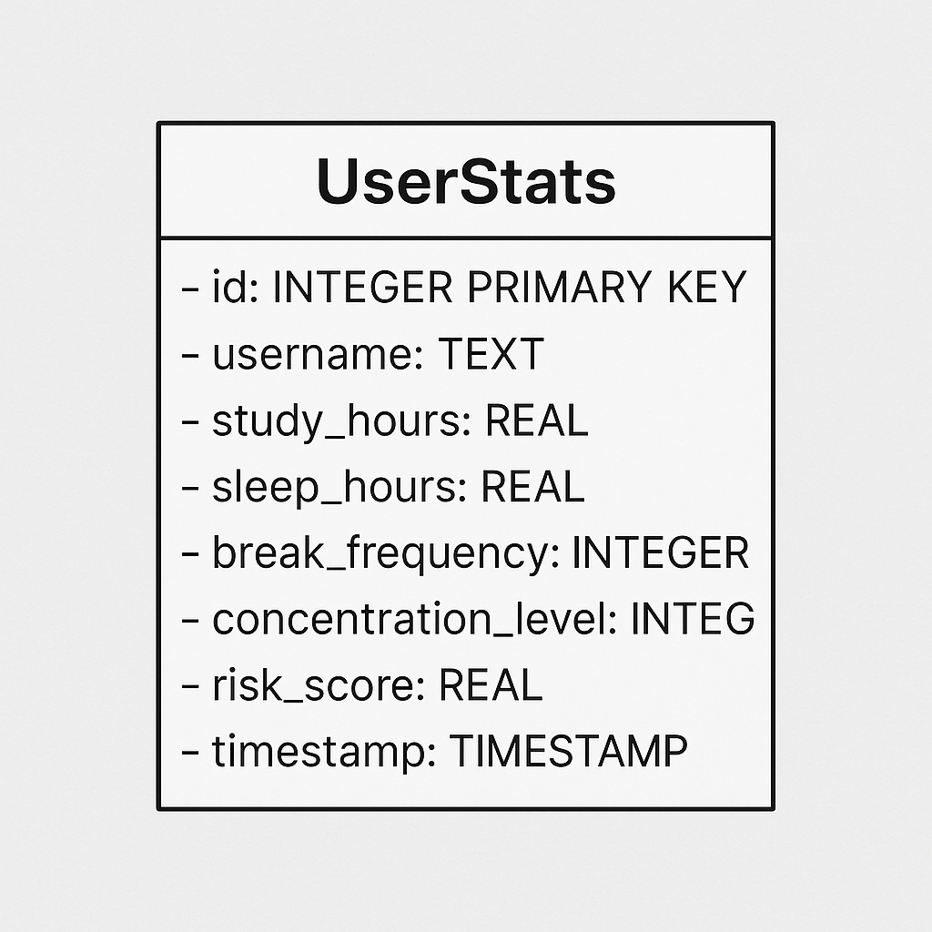
06
API & Backend Logic
Backend API Overview
/analyze — Accepts input, returns ML + rule + AI analysis
/history — Returns session data by user + time range
/usernames — Returns recent usernames
/clear-history — Deletes session data for a user in selected range
Database Schema (SQLite)

Slide 9
07
User Flow
Student opens app, enters daily stats
System analyzes and displays visual + textual feedback
User receives an AI tips on how to improve
Past entries are stored and can be reviewed/deleted

Slide 10
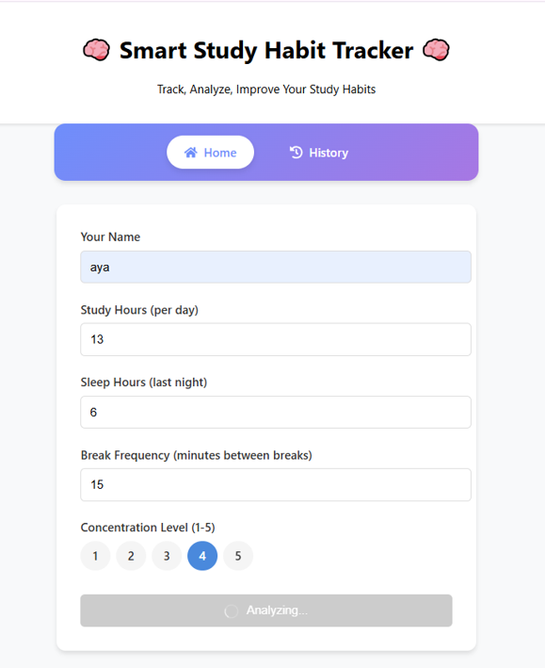
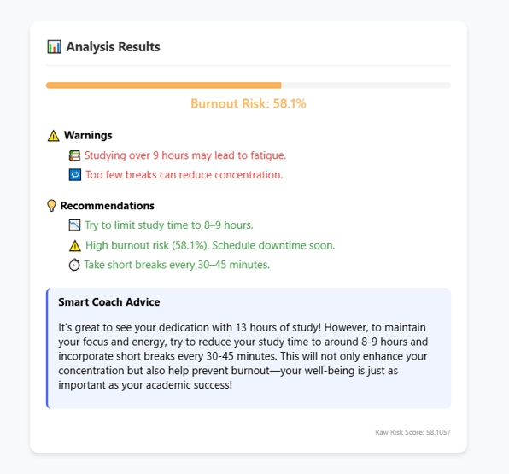
07
User Flow

Slide 11
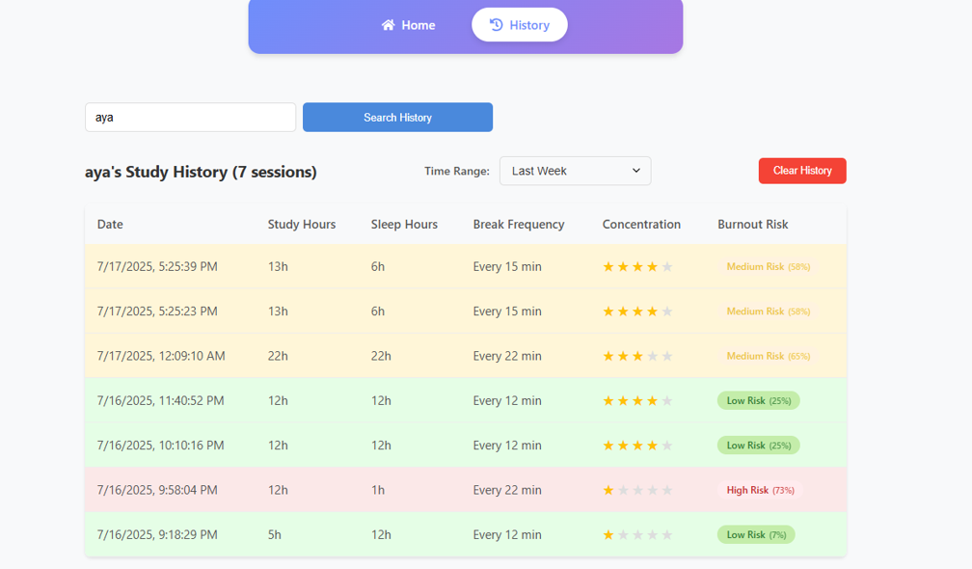
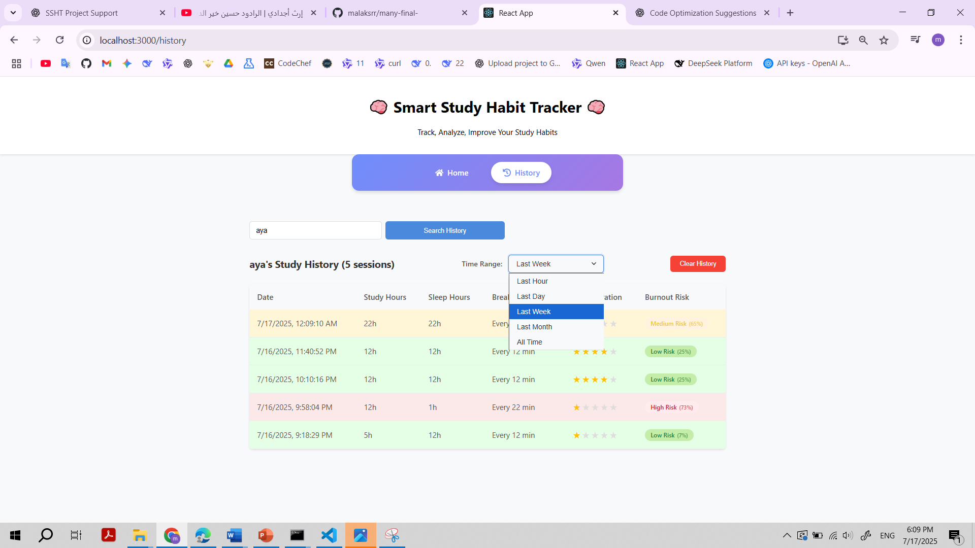
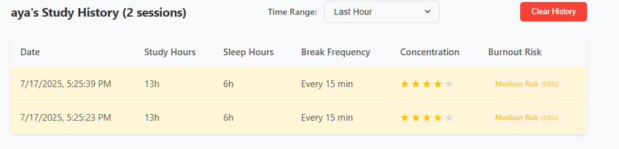
07
User Flow

Slide 12
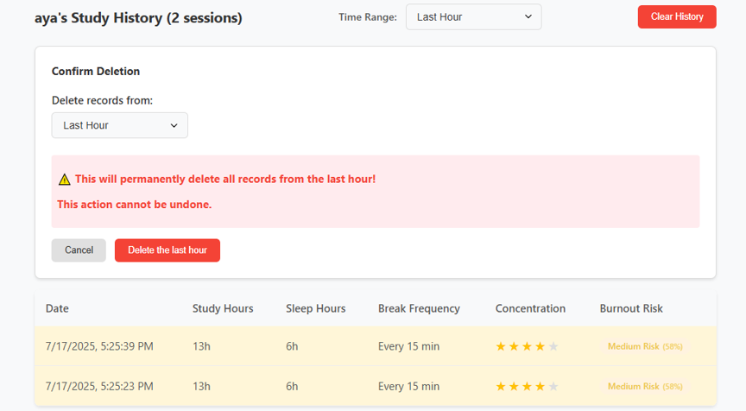
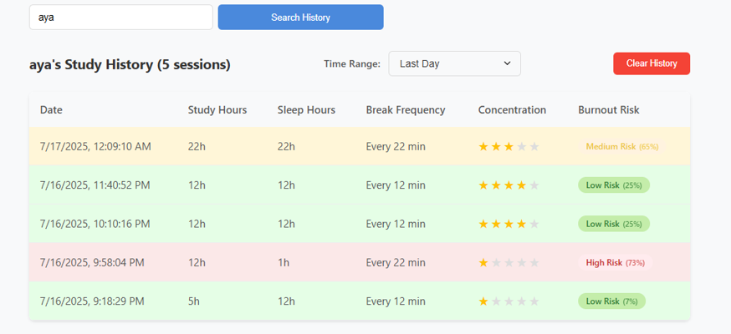
07
User Flow

Slide 13
08
Challenges Faced
Handling asynchronous data flow between React and Flask
Ensuring data validation across client and server
Missing of training data
Preventing OpenAI API key leakage
Avoiding API key exposure in GitHub

Slide 14
09
Future Improvements
Add login system and secure user authentication
Use charts (e.g. Recharts) for historical trends
Train a more accurate burnout detection ML model with custom data
Make it suitable for mobile

